Slide 1
Data Quality
Business Intelligence & Analytics

Slide 2
Data quality is a perception or an assessment of data's fitness to serve its purpose in a given context. The quality of data is determined by factors such as accuracy, completeness, reliability, relevance and how up to date it is.
https://searchdatamanagement.techtarget.com/definition/data-quality
Notes:
Data quality is very important, which is why we’re not including this in another video

Slide 3
Data quality is a perception or an assessment of data's fitness to serve its purpose in a given context. The quality of data is determined by factors such as accuracy, completeness, reliability, relevance and how up to date it is.
https://searchdatamanagement.techtarget.com/definition/data-quality
Accuracy
Completeness
Reliability
Relevance
How up to date it is
Notes:
Data quality is very important, which is why we’re not including this in another video

Slide 4
Data quality costs
Can cause breakdowns in the value chain (e.g. no items in stock)
Impaired decision-making
Substandard customer service – dissatisfaction and cancellation of business
Lack of trust in reporting
Negatively affects organization’s competitiveness

Slide 5
What to look for
Missing values (e.g. postal code, phone number)
Duplicate values (identical data)
Incorrect values
Qualitative duplicates (references to the same entity where the data is not identical)
Known formats (e.g. phone numbers, states, countries)

Slide 6
Changing business
Changing requirements can cause data quality issues
Example from text – dates collected when we want to know sales by hour
Introduction of new processes will cause nuances in reporting and data quality

Slide 7
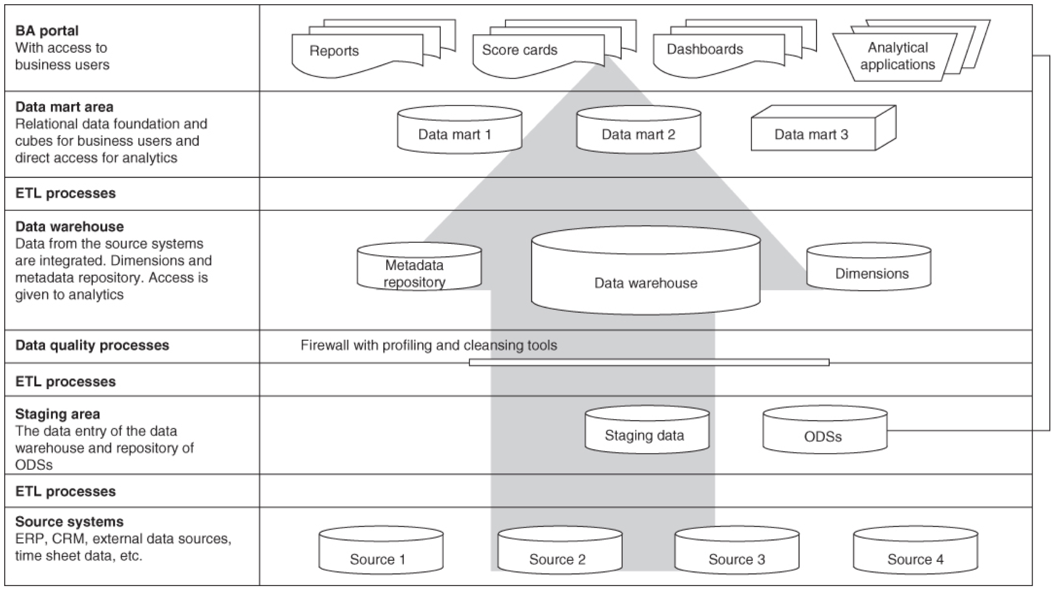

Slide 8
Data quality firewall
Storage layer in data warehouse
Keeps poor quality data out of internal processes and applications
Data that can’t be cleansed is rejected by the firewall
Should always inspect data and revise rules so the firewall keeps up with business needs

Slide 9
Kitty litter principle
Your data is like kitty litter…
Important to have as many people looking in the cat box as possible
Data quality is the responsibility of all employees
Data quality issues should be expected
Data quality issues should be fixed as quickly as possible

Slide 10
Poor data quality is very costly
Data quality can be managed
Data quality is the responsibility of all employees

Slide 11


